Slide 1

Beyond Hijacking: A Robust Defense Framework Against Prompt-Based Attacks in Federated Learning
FYP Defense Presentation By BSCS-F25-019
03-134222-022 | Bisma Amjad
03-134222-044 | Maida Maryam
03-134222-040 | Laiba Iqbal

Slide 2
CLO Mapping
CLO | PLO | Description | Specified Aspects
CLO1 | PLO3:Problem Analysis | Analyze the given problem to propose a computing-based solution. | Identify prompt injection risks in FL, analyze malicious client behavior
CLO2 | PLO4:Design and Development of Solutions | Design and develop computing solutions to complex computing problems. | Develop SecureFL framework with multi-layer defense mechanisms
CLO3 | PLO5:Modern Tool Usage | Demonstrate the ability to use modern tools to solve the given problem. | Use Python, federated learning frameworks, ML models, evaluation metrics
CLO4 | PLO6:Individual and Team Work | Demonstrate the ability to work effectively as an individual and a team member. | Collaborative development, task distribution, integration of modules
CLO5 | PLO10:Life Long Learning | Understand the significance of broader aspects of innovation, potential legal implications, and development. | Explore AI security challenges, ethical risks, future improvements
CLO6 | PLO7:Communication | Demonstrate effective skills in verbal and written communication during presentations, discussions, and reports. | Technical documentation, final report, defense presentation

Slide 3
Abstract

Slide 4
What
Secure federated learning framework
Detect malicious client updates
Handle prompt injection attacks

Slide 5
WHY
AI systems widely deployed
Increasing security vulnerabilities
Prompt injection manipulates models
FL vulnerable to hidden attacks

Slide 6
HOW
Multi-layer defense mechanism
Cosine similarity analysis
Statistical anomaly detection
Trust-based client scoring
Secure aggregation strategy

Slide 7
Objectives

Slide 8

To detect malicious client updates
To prevent prompt injection attacks
To design trust-based detection system
To implement similarity-based filtering
To evaluate model performance and security
To develop real-time monitoring dashboard

Slide 9
Deliverable and Beneficiaries

Slide 10
Deliverables
Following are the deliverables
SecureFL defense framework
Federated learning training system
Malicious client detection module
Real-time monitoring dashboard
Experimental evaluation results

Slide 11
Beneficiaries
Following are the beneficiaries
AI researchers and developers
Cybersecurity analysts
Organizations using federated learning
Distributed AI system users
Academic and research community

Slide 12

Scope

Slide 13
PRIMARY
Secure federated learning system
Detect malicious client updates
Handle prompt injection attacks
Trust-based aggregation mechanism
Real-time monitoring and alerting

Slide 14
OPTIONAL
Cross-dataset evaluation setup
Scalable real-world deployment
Handling complex attack scenarios

Slide 15
SRS / Literature Review

Slide 16
Existing Research Focus
Prompt injection in LLMs
Byzantine robust aggregation
Federated poisoning defenses
Trust-based client selection

Slide 17
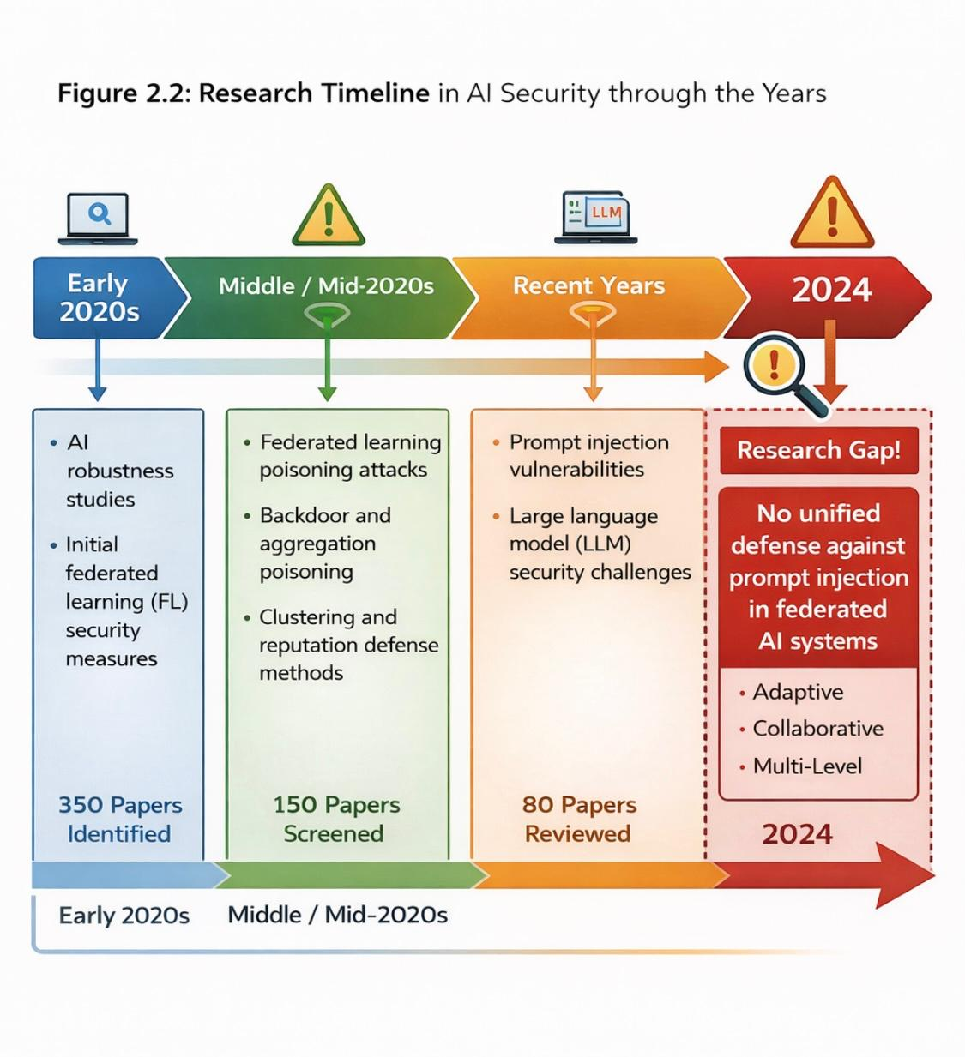
Research Gap
No unified defense framework
Limited prompt level protection
Lack of runtime monitoring
Weak integration with federated learning
Figure 1: Research Timeline in AI Security through the Years

Slide 18
SDS / Methodology

Slide 19
SecureFL Architecture
Federated client-server environment
Multi-layer defense mechanism
Similarity based anomaly detection
Trust score evaluation system
Secure aggregation process

Slide 20
Core Security Features
Cosine similarity analysis
Z-score statistical filtering
Historical behaviour tracking
Differential privacy support

Slide 21
Experimental Setup

Slide 22
Experiment 1
Prompt Injection in the Wild dataset
Real-world adversarial scenarios
Baseline vs SecureFL comparison

Slide 23
Experiment 2
PIDTC for training
PIDEC for testing
Cross-dataset evaluation

Slide 24
Evaluation metrics
Accuracy
Precision
Recall
F1-Score
Attack Success Rate (ASR)

Slide 25
Implementation

Slide 26
System Components
Federated server module
Secure aggregation layer
Trust evaluation engine
Dashboard visualization system
Alert and monitoring module

Slide 27
Security Mechanisms
Gradient clipping
Dynamic trust weighting
Statistical anomaly detection
Behaviour consistency analysis

Slide 28
Results and Discussion

Slide 29
Observed Results
Improved detection accuracy
Reduced malicious client influence
Lower attack success rate
Better model reliability
Enhanced aggregation robustness

Slide 30
Comparative Findings
SecureFL outperformed baseline
Advanced model more resilient
Trust-aware filtering effective

Slide 31
System Impact and Applications

Slide 32
Real World Applications
Healthcare AI systems
Smart banking systems
Autonomous AI platforms
Distributed enterprise systems
Secure collaborative learning

Slide 33
System Benefits
Improved AI security
Better client trust management
Real-time attack monitoring
Enhanced model transparency

Slide 34
Conclusion and Recommendations

Slide 35
Conclusion
SecureFL successfully detects attacks
Trust-aware aggregation improves security
Multi-layer defense enhances reliability
Real-time monitoring increases transparency

Slide 36
Recommendations
Deploy in real-world FL systems
Support larger client environments
Extend to advanced attack patterns
Improve adaptive defense intelligence

Slide 37
Thank You

Slide 38
Project Title
Thanks
Please feel free to:
Ask any further details
Advise any improvements
FYP Defense Presentation By GroupID
03-134222-022 | Bisma Amjad
03-134222-044 | Maida Maryam
03-134222-040 | Laiba Iqbal

